Slide 1
Getting started with C++

Slide 2
What is a Program?
What do you mean by High Level Language and a Low level Language?
What is the main difference between a compiler and an interpreter?

Slide 3
Tokens(Lexical Unit)
Tokens are the smallest individual unit in a program. C++ has the following tokens:
Keywords :- are the words that convey a special meaning to the language compiler.
eg: int, float, if, for, while
Identifiers :- They are the fundamental building blocks of a program and are used as the general terminology for the names given to different parts of the program.
Eg: Myfile, _CHK

Slide 4
Literals :- Literals are referred to as constants, are the data items that never change their value during a program run.
C++ has several kinds of literals
Bool literal (true or false)
Integer constant ( decimal, Octal and hexadecimal).
Character constant ( escape sequence \n \t )
String literals (multiple character form string)
Floating constants(fractional and exponential part).

Slide 5
Puntuators :-
Braces : { } – indicates the start of the compound statement( block of code containing more than one executable statement.
Brackets [] - array
Paranthesis – () – function call and parameters
Comma- , - separator in function list.
Semicolon - ; - statement terminator.
Equal sign - = - assignment , variable initialization
Colon - : - indicates a labeled statement.

Slide 6
Operators

Slide 7
Relational Operators
< [less than]
> [greater than]
<= [less than or equal]
>= [greater then or equal]
== [ equals]
!= [Not equals]
Always returns a True[1] or False [0] value

Slide 8
Logical Operators
AND [&&] eg: X && Y
OR [||] eg: X || Y
NOT [!] eg: !X

Slide 9
Truth table for AND operator
X | Y | X && Y
T | T | T
T | F | F
F | T | F
F | F | F

Slide 10
Truth table for OR operator
X | Y | X || Y
T | T | T
T | F | T
F | T | T
F | F | F

Slide 11
Truth table for NOT operator
X | !X
T | F
F | T

Slide 12
What is a data type?
In computer programming, information is stored in a computer memory with different data types.
We must know what is to be stored in a computer memory, whether it is a simple number, a letter or a very large number.
As we also know, computer memory is organized in bytes, and for these variables with varying information a data type is associated.
The minimum amount of memory in computer memory is a byte, that can store a small amount of data and managed easily.

Slide 13
Every variable is declared with two entities, its type and its name. There are several data types available in C++.
Eg : <data type> <variable name>;
int a;
// int is the data type and a is the variable;
The basic built in data types or the fundamental data types are char, int, float, double and void
C++ also allows user defined data types like class, structure etc.

Slide 14
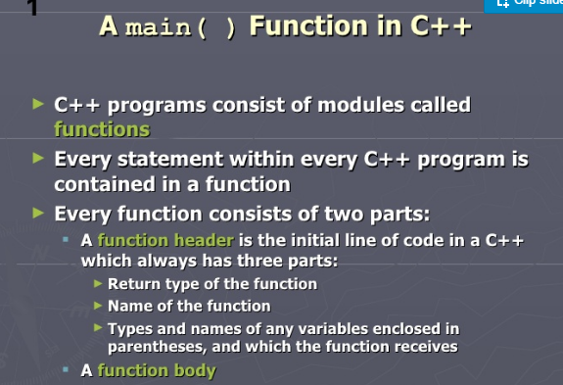

Slide 15
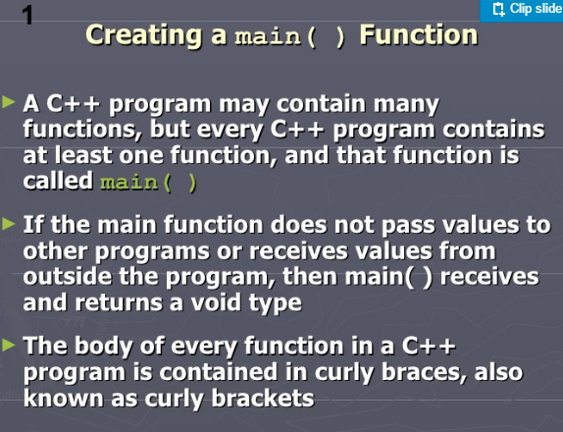

Slide 16
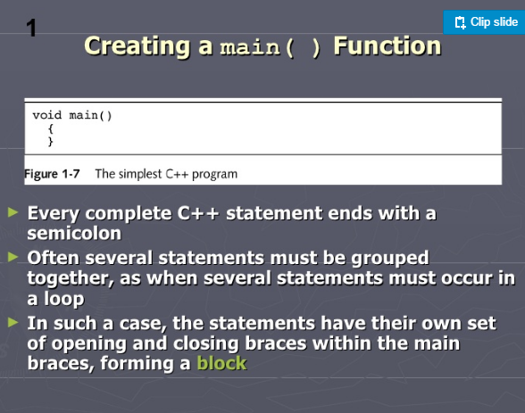

Slide 17
cin && cout
cin is known as the standard input stream
cout is know as the standard output stream
cout<<“hello world”;
will display hello world on the screen
int a; // declare a variable
a=10; // assign the variable value
cout<<a; // will display the value of a on the screen
cout<<“a=“<<a;
//will display a=10 on the screen

Slide 18
C++ Program starts with header file
#include<iostream.h> header file
#include<conio.h>
void main()
{
cout<<“Hello world”;
getch();
}
OUTPUT :
Hello world

Slide 19
Output operator <<
Syntax:
cout<<“ Hello “;
Input operator >>
Syntax:
cin>> var;
Prints the text on the screen
Accepts an input from the user

Slide 20
Eg: Accept the age from the user and display it
int age; // variable age is declared as integer type
cout<<“Enter your age”; // This stmt is displayed on the monitor
cin>>age; // value of age is inputted from the user
cout<<“The age of the person is :”<<age;
// the age of the person is displayed
Output of the program is
Enter your age
56
The age of the person is:56

Slide 21
Variable declaration
Syntax:
<data type> <var1>,<var2>………..;
Eg: int a,b,c;
float sum, avg;
Variable initialization
Syntax:
data type var=value;
Eg: int a=5;
float sal=250.50

Slide 22
What is a variable?
A variable is a value that can change, depending on conditions or on information passed to the program.
Eg :
int a=5;
a=a+10;
cout<<“a=“<<a;
a=a*10;
cout<<“\n A=“<<a;
OUTPUT
a=15
A=150

Slide 23
Variables
Rules for variable names:
Variable name should always start with an alphabet.
Special symbols (like $,%,-) are not permitted except underscore( _ ).
Digits are permitted.
Blank space is not permitted.
Keywords are not permitted, but we can use the keywords along with alphabets or digits.

Slide 24
Egs of variable assignments
Sum=5;
Total sum=10 ;
Total-sum=10;
Total_sum=10;
Sum123=100;
1st Term=2400;
First_Term=2400;
//valid
//Invalid
//Invalid
//valid
//valid
//Invalid
//valid

Slide 25
Syntax in C++
Each and every statement in c++ ends with a semicolon.
A=5; // valid
A=x+4; // valid
5=A; // Invalid
X+3=A; // Invalid
The value from the right side goes to the left side.
In c++ all the expressions and constants will come on the right side of assignment operator.

Slide 26
Data types in C++
Data Type | Memory (ByteS) | Minimum Value | Maximum Value
Bool | 1 | Logical Value T/F | Logical Value T/F
Char / signed char | 1 | -128 | 127
Unsigned Char | 1 | 0 | 255
Short | 2 | -32768 | 32767
Unsigned Short | 2 | 0 | 65535
int | 2 | -32768 | 32767
unsigned int | 2 | 0 | 65535
Long | 4 | -2147483648 | 2147483647
unsigned long | 4 | 0 | 4294967295
float | 4 | 10⁻³⁸ | 10³⁸
double | 8 | 10⁻³⁰⁸ | 10³⁰⁸
long double | 10 | 10-4932 | 10⁴⁹³²

Slide 27
Data type modifiers
signed
unsigned
long
short

Slide 28
Pgm 2
#include<iostream.h>
#include<conio.h>
void main()
{ clrscr(); // clears the screen
int a;
cout<<“Enter a number :”;
cin>>a;
cout<<“The number is :”<<a;
getch();
}
OUTPUT
Enter a number : 10 The number is:10

Slide 29
Initialization of variables
Static
Dynamic

Slide 30
Value Assignment
Eg: int a;
a=10; // value is assigned to a
Dynamic initialization
Meaning value is not assigned in the beginning
Eg: int sum, count;
cin>>sum>>count;
float total=sum/10;

Slide 31
Access Modifier
Constant variable
const int a=5;
a=a+5; // not allowed
float b=6.9;
b=b+a; //allowed

Slide 32
Escape sequence
\n → line feed (new line)
\t → tab space (8 spaces)
\b → back space
\a → alert sound (beep)
Q. Write the stmt to get the foll output.
1. BGS
NPS
2. B
G
S
N
P
S
3. BGS NPS

Slide 33
Eg: Accept the age from the user and display it
Int age;
cout<<“Enter your age : \n”;
cin>>age;
cout<<“\n The age of the person is :\t ”<<age;
Output of the program is
Enter your age
56
The age of the person is: 56

Slide 34
Arithmetic operators
Operators | Usage | Examples
+ Sum | x+1 or x+y | X=5, y=6 Sum= X+y Sum=11
- Difference | x-1 or x-y | Diff=x-y Diff=-1
* Product | x*3 or x*y | Prod=x*y Prod= 30
/ Quotient | c/3 or x/y | X=5,y=2 Quot=X/y Quot=2.5
% Remainder | s%2 or x%y | Rem=x%y Rem=1

Slide 35
W.A.P to enter the user class and section and display then.
#include<iostream.h>
#include<conio.h>
void main()
{ clrscr();
int cl; char sec;
cout<<“ Enter the person’s class and section :”;
cin>>cl; cin>>sec
cout<<“ \n the person’s class is :” <<cl<<“ section :”<<sec;
getch();
}
Output
Enter the person’s class and section : 5
A
The person’s class is: 5 section A

Slide 36
2. W.A.P to enter the user age and display his age after 15 years.
#include<iostream.h>
#include<conio.h>
void main()
{
int age,nage;
cout<<“ Enter the person’s age :”;
cin>> age;
nage=age+15 // or age=age+15
cout<<“ \n the person’s age after 15 years :” <<nage; // or age
getch();
}
Output
Enter the person’s age: 23
the person’s age after 15 years : 38

Slide 37
3. W.A.P to accept your marks in three subject and display them
#include<iostream.h>
#include<conio.h>
#include<stdio.h>
void main()
{
clrscr();
int m1,m2,m3;
cout<<“ Enter Science mark:”;
cin>> m1;
cout<<“ \nEnter Maths mark:”;
cin>> m2;
cout<<“\n Enter English mark:”;
cin>> m3;
cout<<“ \n Science marks :” <<m1<<“\n Maths marks :”<<m2<<“ \n English marks :”<<m3;
getch();
}

Slide 38
Escape sequence
Q. Write the pgm to get the following output.
4. BGS
NPS
5. B
G
S
N
P
S
6. BGS NPS

Slide 39
To find the circumference and area of a circle
To find the sum, product and difference of any two given number.
To find the percentage of the student in 5 main subject
To find the area of a triangle.
Volume of a sphere
Volume of cylinder
Volume of Cube.

Slide 40
Conditional operator
Syntax:
var=(condition)?true stmt: False stmt;
Eg: to find the bigger of two numbers.
int Big;
cin>>a>>b;
Big=(a>b)?a:b;
cout<<“ Greater value is :”<<Big;
Or
(a>b)?cout<<“ a is greater”:cout<<b<<“ is greater”;

Slide 41
13 Write a c++ stmt to identify whether a number is positive or negative.
Ans: void main()
{
int num;
cout<<“ Enter the number”;
cin>>num;
(num>0)? Cout<<“Number is positive”: cout<<“ Number is negative”;
}

Slide 42
14. Write a c++ stmt to identify whether a number is even or odd.
Ans: void main()
{
int num;
cout<<“ Enter the number”;
cin>>num;
(num%2==0)? cout<<“Number is even”: cout<<“ Number is odd”;
}

Slide 43
15. Write a c++ stmt to identify whether the given age is eligible to vote or not
Ans: void main()
{
int age;
cout<<“ Enter the age”;
cin>>age;
(age>=18)?(age>=60)?cout<<“Senior Citizen”: cout<<“ eligible to vote”:cout<<“Not Eligible”;
}

Slide 44
16. Write a c++ stmt to identify whether the given number is a multiple of 6 and a multiple of 5
Ans: void main()
{
int num;
cout<<“ Enter the num”;
cin>>num;
(num%6==0 && num%5==0)? cout<<“Multiple of 6 and 5”: cout<<“ Not a multiple of 6 and 5”;
}

Slide 45
16. Write a c++ stmt to identify whether the given number is a multiple of 6 and a multiple of 5
17 .Number is a 2 digit
18 .Number is a 2 or a 3 digit

Slide 46
17. Write a c++ stmt to identify whether the given number is a 2-digit number
Ans: void main()
{
int num;
cout<<“ Enter the num”;
cin>>num;
(num>9 && num<100)? cout<<“two digit number ”: cout<<“ Not a two digit number”;
}

Slide 47
17. Write a c++ stmt to identify whether the given number is positive, negative or zero
Ans: void main()
{
int num;
cout<<“ Enter the num”;
cin>>num;
(num==0)? cout<<“Number is zero”: (num>0)?cout<<“ Number is positive”:cout<<“Number is negative”;
}

Slide 48
USE OF Logical operator with Condition
AND operator ( &&) - used when both the condition has to be satisfied.
eg (a>10 && a<100)?
cout<<“2 digit”
: cout<<“Not a 2 digit “;
(a>-25 && a<25) ? cout<<“between 25 & -25”
: cout<<“Not between 25 & -25“;
OR operator (||) – used when either one of the condition has to be satisfied.
eg (a%6==0 || a%5==0)?

Slide 49
NOT Operator (!)
(a!=9)? cout<<“Not a 9”: cout<<“ITS 9”;
(a)
17 . W.A.P using conditional operator to find the largest and the smallest of 3 numbers.

Slide 50
Increment Operator (++)
A++ → A=A+1 // Post Increment
++A → A=A+1 // Pre Increment
How does it function
A=2;
cout<<A++;
// Output will be 2
cout<<++A;
// output will be 4
cout<<A;
//output will be 4

Slide 51
Int x=5, y=2;
Cout<< x+y;
Cout<< ++x + ++y;
Cout<< x++ + y++;
Cout<<x+y;
7
9
9
11

Slide 52
Decrement Operator (--)
A-- → A=A-1 // Post decrement
--A → A=A-1 // Pre decrement
How does it function
Int A=5;
Cout<<A--;
Cout<< --A;
Cout<<A;
But the value of A will be 4 after A is printed
5
3
3

Slide 53
int i=7,j=10;
cout<<i--;
cout<<--i;
cout<<i++ + --j;
cout<<++j + j--;
cout<<i<<“\t”<<j;
7
5
14
20
6 9

Slide 54
int a=10,b=15;
cout<<a++<<“ “<<b++<<endl;
10 15
cout<<++a<<“ “<<b--<<“ “<<--a<<endl;
11 16 10
cout<< --a<< “ “<<++b<<endl;
10 16

Slide 55
A=5;
cout<<A++;
cout<<++A;
A=5
cout<<A++<<“ “<<++A;

Slide 56
int p=5,q=10,r=15,s=20;
cout<<p++ + --s<<endl;
cout<< s-- + ++q<<endl;
cout<<r++ - ++p<<endl;
cout<<++s + --r<<endl;
cout<<p++ + q++ + ++r + s++<<endl;
cout<<p<<“ “<<q<<“ “<<r<<“ “<<s;

Slide 57
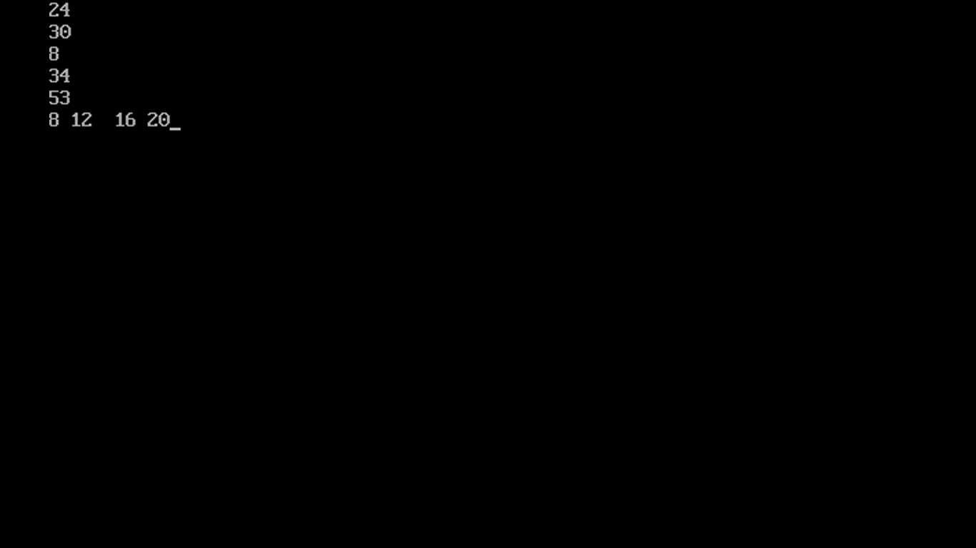

Slide 58
int p=5,q=10,r=15,s=20;
int z= (p+q > r+s)?p++:q++;
int y=(p+r < q+s)?++r+2: ++q+2;
cout<<“z=“<<z<<“\t y=“<<y;
cout<<p<<“ “<<q<<r<<s;

